Slide 1
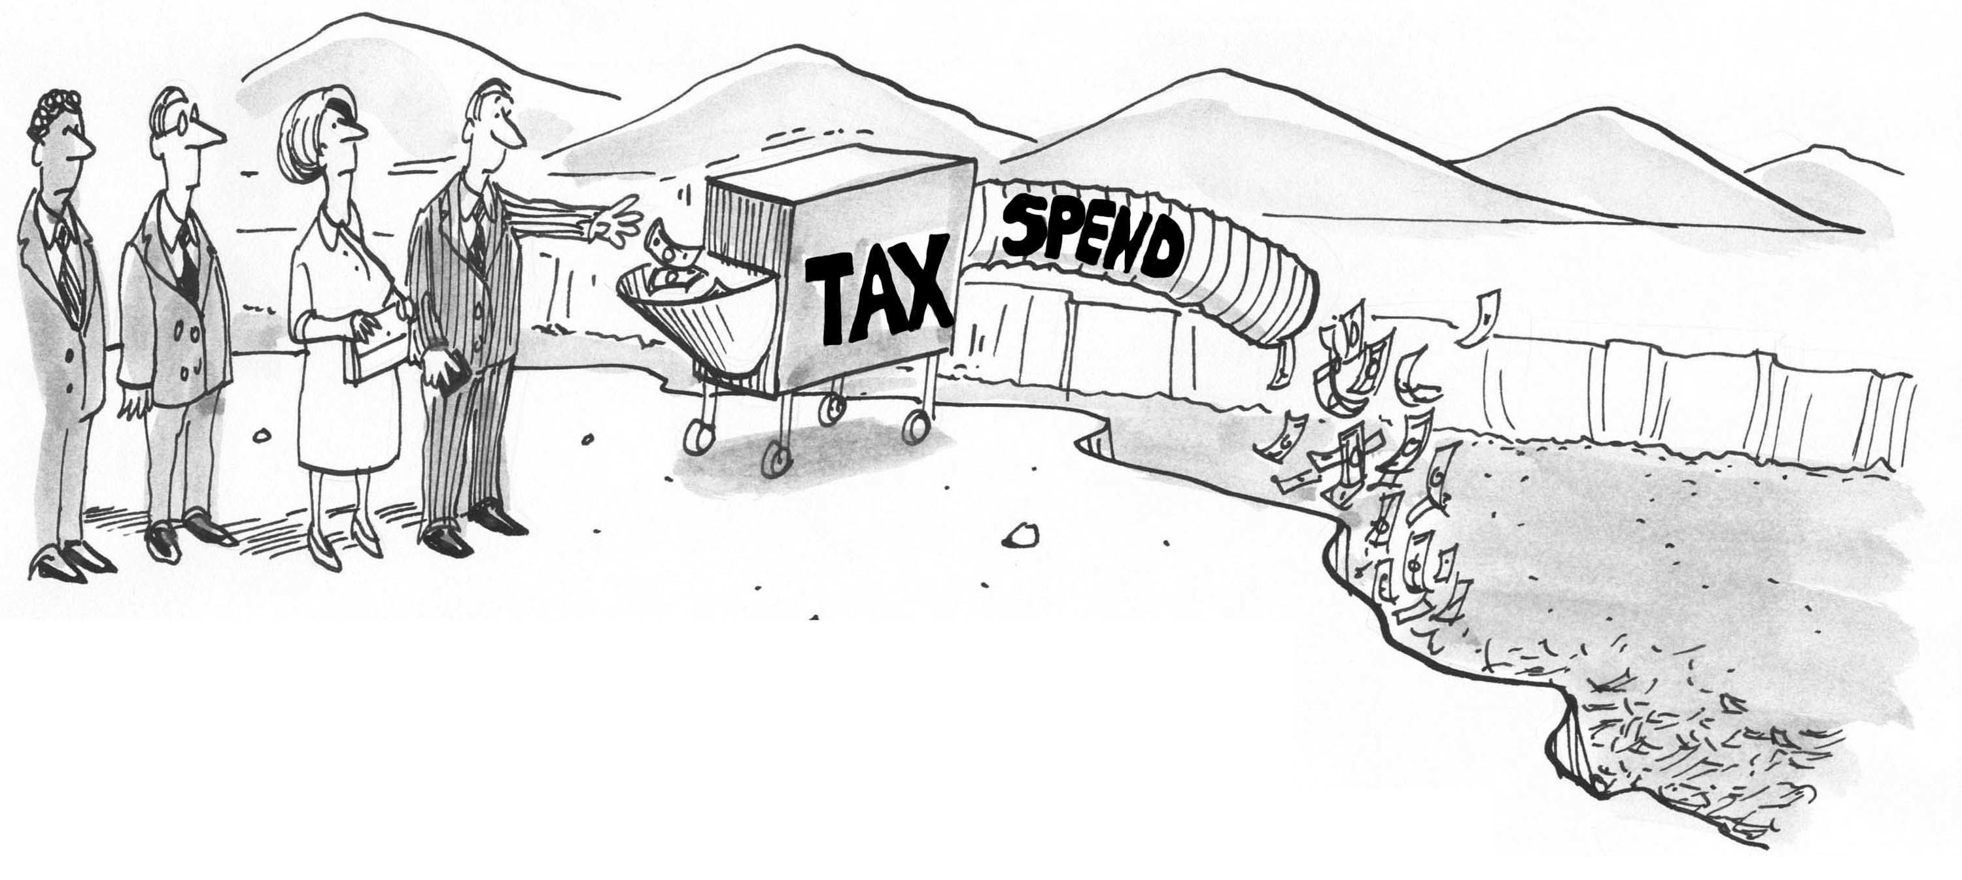
Introduction to Fiscal Policy

Slide 2
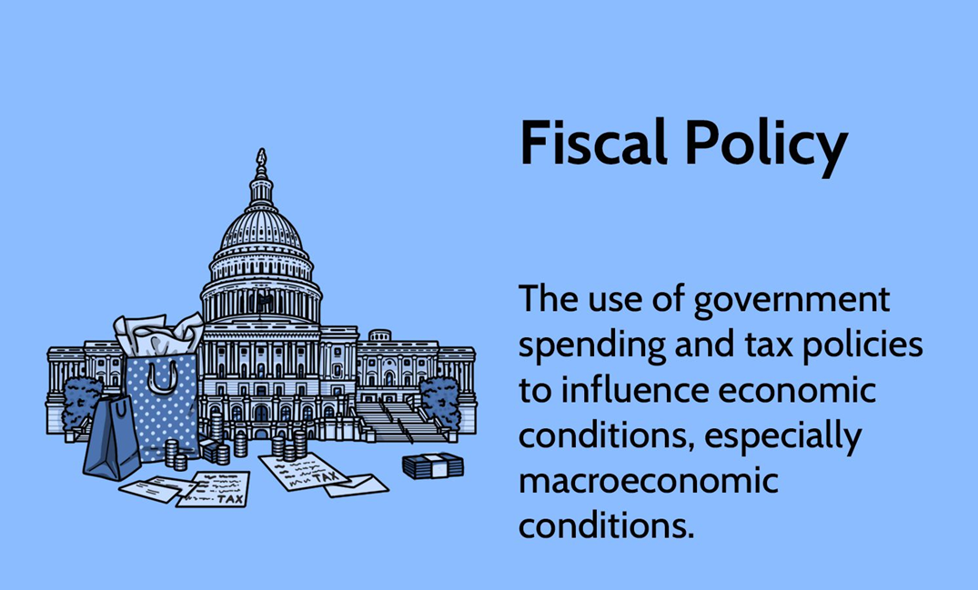
What is fiscal policy?
Notes:
The use of taxation and spending by the government to affect the economy is referred to as fiscal policy. It is a crucial instrument for governments to use in achieving macroeconomic objectives including job growth, inflation control, and unemployment reduction. Fiscal policy works by changing the economy’s total demand, which therefore has an impact on the level of economic activity. To accomplish its desired economic results, the government can either raise or decrease spending and/or change tax rates. This is accomplished via a range of policy tools, such as adjustments to transfer payments, tax rates, and government spending. The timing of implementation, the scope of the policy response, and the health of the economy are only a few of the variables that affect how effective fiscal policy is.
Meaning of Fiscal Policy
Government strategy for managing its budget to influence the economy.
Balances taxation and government spending to achieve economic goals.

Slide 3
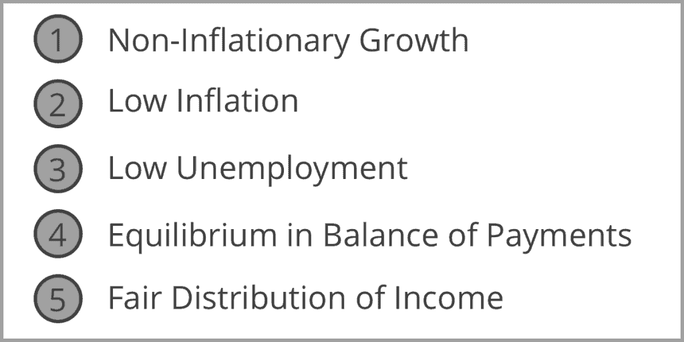
Macroeconomic Objectives
Notes:
The macroeconomic objectives of an economy are broad goals that governments and policymakers aim to achieve to ensure stable and sustainable economic growth and development. These objectives serve as guiding principles for economic policy formulation and implementation. The main macroeconomic objectives typically include:
Price Stability: Price stability refers to keeping inflation rates low and stable over time. Moderate and stable inflation is desirable because it provides certainty for businesses and households, encourages long-term planning and investment, and preserves the purchasing power of money. Excessive inflation erodes the value of money, distorts price signals, and reduces consumer and investor confidence.
Full Employment: Full employment means that everyone who is willing and able to work can find a job at prevailing wage rates. Achieving full employment promotes social stability, reduces poverty and inequality, and maximizes the productive potential of the economy. Unemployment not only leads to lost output and income but also imposes significant social and psychological costs on individuals and communities.
Economic Growth: Economic growth refers to the sustained increase in the production of goods and services (real GDP) over time. Economic growth is essential for improving living standards, reducing poverty, and creating opportunities for prosperity and advancement. It allows the economy to expand its capacity to produce goods and services, generate employment, and enhance the overall well-being of society.
Income Distribution: Income distribution concerns the equitable distribution of income and wealth among different segments of the population. While some level of income inequality is inevitable in any market economy, excessive inequality can lead to social tensions, undermine social cohesion, and hinder sustainable economic growth. Policies aimed at promoting income redistribution, improving access to education and healthcare, and providing social safety nets can help reduce inequality and enhance economic inclusiveness.
External Balance: External balance refers to achieving equilibrium in the economy's international trade and financial transactions. It involves maintaining a sustainable balance of payments position, stable exchange rates, and prudent management of external debt. A healthy external balance ensures that the economy can finance its imports without relying excessively on external borrowing or depleting foreign exchange reserves.
These macroeconomic objectives are interconnected and mutually reinforcing. For example, achieving full employment and promoting economic growth can help reduce poverty and inequality, while maintaining price stability and external balance supports overall macroeconomic stability and sustainability.
These objectives are necessary because they provide a framework for policymakers to assess the performance of the economy, prioritize policy interventions, and make informed decisions to promote long-term economic prosperity and well-being. By pursuing these objectives in a balanced and coordinated manner, governments can create an environment conducive to sustainable economic growth, stability, and prosperity for all members of society.
Non-inflationary economic growth refers to a situation where an economy experiences sustained expansion in its output (real GDP) without causing a significant increase in the general price level (inflation). In other words, it describes a scenario where economic growth occurs without generating inflationary pressures.
Key characteristics of non-inflationary economic growth include:
Productivity Improvements: Economic growth driven by increases in productivity, efficiency, and technological advancements tends to be less inflationary. When firms produce more goods and services using the same or fewer resources, they can meet rising demand without raising prices.
Supply-Side Policies: Policies aimed at improving the supply-side of the economy, such as investments in infrastructure, education, and research and development, can support non-inflationary growth. These policies enhance the economy's productive capacity, allowing it to meet growing demand without triggering inflation.
Flexible Labor Markets: Labor market flexibility, including measures to enhance labor market efficiency, reduce rigidities, and promote skills development, can contribute to non-inflationary growth. A flexible labor market allows firms to adjust wages and employment levels in response to changes in demand without causing inflationary wage pressures.
Monetary Policy Credibility: A credible and effective monetary policy framework, characterized by clear communication, transparent decision-making processes, and a commitment to price stability, can help anchor inflation expectations and prevent inflation from rising during periods of economic expansion.
External Balance: Non-inflationary growth requires maintaining external balance, including sustainable trade balances and stable exchange rates. Excessive external imbalances, such as large trade deficits or rapid currency depreciation, can fuel inflationary pressures by increasing the cost of imported goods and services.
Achieving non-inflationary economic growth requires a careful balance of macroeconomic policies, including monetary policy, fiscal policy, and structural reforms. Policymakers must aim to support sustainable economic expansion while maintaining price stability and avoiding overheating of the economy. By pursuing policies that enhance productivity, boost supply-side capacity, and promote macroeconomic stability, economies can achieve long-term growth without fueling inflationary pressures.

Slide 4
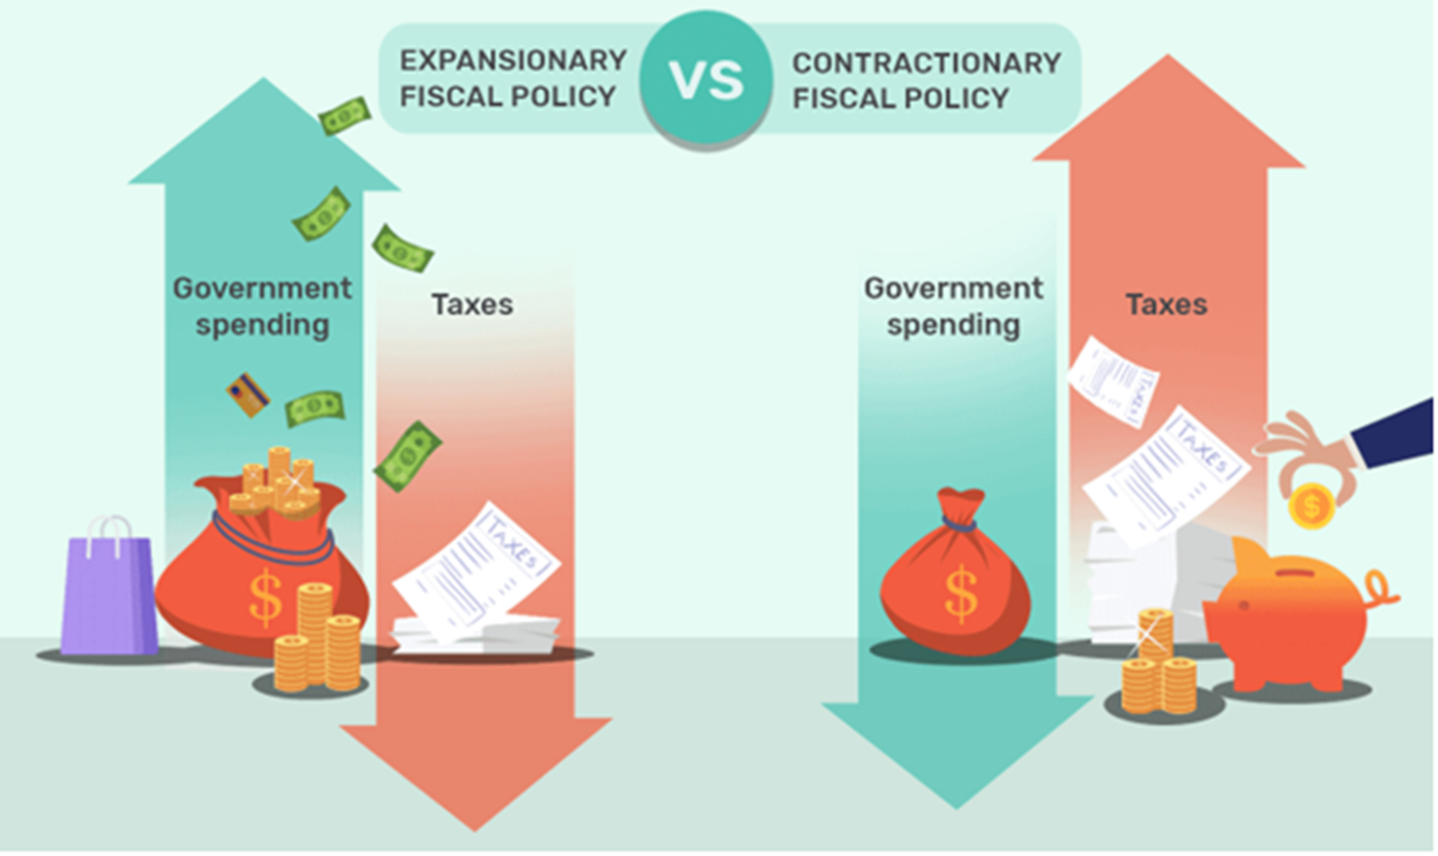
Types of Fiscal Policy
Notes:
There are two main types of fiscal policy:
Expansionary fiscal policy
Contractionary fiscal policy
Expansionary Fiscal Policy
Expansionary fiscal policy refers to measures taken to increase demand and economic growth by lowering taxes or increasing government spending. In order to increase demand and encourage economic activity, these policies are generally used during periods of economic recession or slowdown.
Governments can execute expansionary fiscal policy in a number of ways:
Increase government spending: Spending increases by governments are possible in a number of areas, including infrastructure, education, and defence. This can boost the economy’s demand and generate jobs.
Reduce taxes: To boost disposable income and promote spending, governments might lower taxes on individuals or corporations. This could increase demand and promote economic expansion.
Implement transfer payments: Transfer payments, like social security or unemployment benefits, which put money in the hands of those who are likely to spend it, are another way for governments to boost demand.
It is important to keep in mind that an expansionary fiscal policy may result in higher budget deficits since the government is spending more than it is bringing in through taxes. This could be a problem if the deficit grows too large since it could result in higher levels of government debt.
Contractionary Fiscal Policy
In order to lower demand and moderate the economy, methods known as contractionary fiscal policy involve raising taxes or cutting back on spending by the government. These measures are often employed to lower demand and prevent economic overheating during periods of inflation or economic boom.
Governments can adopt a contractionary fiscal policy in a number of ways:
Reduce government spending: Governments have the option of reducing their expenditures on a range of products and services, including infrastructure, training, and defence. This might lower economic demand.
Tax increases: Governments can raise taxes on citizens or corporations to reduce disposable income and deter expenditure. This can lower demand and cause a slowdown in the economy.
Implement austerity measures: Governments can also enact austerity measures to lower spending and demand, such as reducing social safety programs.
In light of the fact that the government is collecting more money in tax receipts than it is spending, it is important to note that contractionary fiscal policy can result in lower budget deficits or even budget surpluses. However, as it decreases demand in the economy, contractionary fiscal policy can also cause a slowdown or recession.

Slide 5
Types of Fiscal Policy
Discretionary Fiscal Policy
A fiscal policy action that is being initiated by the government to achieve it’s macroeconomics goals
Non-discretionary Fiscal policy
A fiscal policy action that is being triggered by the state of the economy
For example, an increase in unemployment induces an increase in payments to the unemployed
Notes:
Discretionary fiscal policy and non-discretionary fiscal policy refer to two different approaches that governments use to manage their finances and influence the economy:
Discretionary Fiscal Policy:
Discretionary fiscal policy involves deliberate and active decisions by policymakers to adjust government spending and taxation in response to economic conditions. These policy actions are typically discretionary because they are based on the judgment and discretion of policymakers rather than being automatically determined by existing laws or programs.
Examples of discretionary fiscal policy measures include changes in government spending on infrastructure projects, education, healthcare, defence, and social welfare programs, as well as adjustments to tax rates, tax credits, and deductions.
For instance, during an economic downturn, a government may implement expansionary discretionary fiscal policy by increasing government spending on public works projects (such as building roads and bridges) to stimulate economic activity and create jobs. Alternatively, during periods of high inflation or economic overheating, policymakers may adopt contractionary discretionary fiscal policy by reducing government spending or raising taxes to cool down the economy and prevent inflation from spiraling out of control.
Non-discretionary Fiscal Policy:
Non-discretionary fiscal policy, also known as automatic stabilizers, refers to built-in features of the tax and spending system that automatically adjust in response to changes in economic conditions without requiring explicit legislative action.
Examples of non-discretionary fiscal policy measures include progressive income taxes, unemployment insurance, welfare programs, and certain entitlement programs (such as Social Security benefits). These programs automatically expand during economic downturns to provide income support to individuals and families affected by unemployment or economic hardship, thereby stabilizing aggregate demand and cushioning the impact of recessions.
For instance, during a recession, automatic stabilizers like unemployment insurance automatically increase as more people become unemployed, providing additional income to those who have lost their jobs. Similarly, tax revenues may automatically decline during economic downturns as incomes fall, helping to mitigate the overall decline in aggregate demand.
In summary, discretionary fiscal policy involves deliberate government actions to adjust spending and taxation in response to economic conditions, while non-discretionary fiscal policy consists of automatic stabilizers that automatically respond to changes in the economy without the need for explicit policy decisions. Both discretionary and non-discretionary fiscal policy play important roles in stabilizing the economy and promoting economic growth and stability.

Slide 6
Fiscal Policy Objectives: Economic Growth
GDP = Consumption + Investment + Government Spending + Net Exports
Fiscal Measures – such as government spending increases economic growth
Tax cut increases the disposable income of the household, increasing the consumption level
Tax cut on business increases investment and supply of goods
Notes:
Fiscal policy can affect economic growth by influencing aggregate demand, investment, consumption, and production in the economy. Through changes in government spending and taxation, fiscal policy can stimulate or dampen economic activity, thereby affecting the pace of economic growth. Here's how fiscal policy can impact economic growth, along with an example:
Government Spending and Investment:
Expansionary fiscal policy, which involves increasing government spending on public projects and infrastructure, can boost economic growth by stimulating demand for goods and services and creating jobs.
For example, suppose a government decides to invest in building new highways, bridges, and public transportation systems to improve transportation infrastructure. This increased government spending creates demand for construction materials, labor, and equipment, leading to increased economic activity in related industries. As a result, firms may expand production to meet the rising demand, leading to higher levels of output and employment.
Similarly, investments in education, healthcare, and research and development can enhance human capital and productivity, leading to long-term economic growth and competitiveness.
Taxation and Consumption:
Fiscal policy can also influence economic growth through changes in taxation. Tax cuts can boost disposable income and consumer spending, leading to increased aggregate demand and economic growth.
For example, suppose a government reduces personal income taxes or sales taxes to put more money into the hands of consumers. This increase in disposable income encourages households to spend more on goods and services, leading to higher sales for businesses and increased production. As a result, firms may hire additional workers and invest in expanding their capacity to meet the higher demand.
Similarly, tax incentives for businesses, such as investment tax credits or accelerated depreciation allowances, can stimulate business investment and capital formation, leading to higher productivity and economic growth.
Fiscal Sustainability:
Fiscal policy can also impact economic growth by influencing long-term fiscal sustainability. Excessive government deficits and debt levels can crowd out private investment, raise borrowing costs, and undermine confidence in the economy, thereby impeding economic growth.
For example, suppose a government runs persistent budget deficits, financing its spending by borrowing heavily from financial markets. This can lead to higher interest rates, reducing private sector investment and consumption, and slowing down economic growth over time.
In summary, fiscal policy can affect economic growth by influencing government spending, investment, consumption, taxation, and fiscal sustainability. By adjusting its fiscal stance, a government can stimulate or restrain economic activity, thereby promoting sustainable and inclusive economic growth. However, it's essential for policymakers to carefully calibrate fiscal policy measures to balance short-term economic objectives with long-term fiscal sustainability and stability.

Slide 7
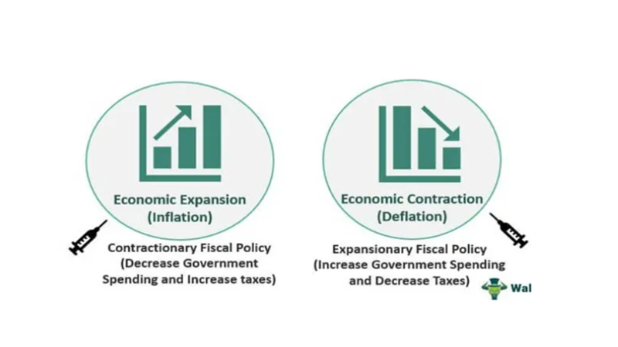
Fiscal Policy Objectives: Inflation
Notes:
Fiscal policy can be used to control inflation through contractionary measures aimed at reducing aggregate demand in the economy. When demand exceeds supply, prices tend to rise, leading to inflationary pressures. By reducing government spending or increasing taxes, fiscal policy can reduce aggregate demand, thereby helping to alleviate inflationary pressures.
Here's how fiscal policy can control inflation with an example:
Reduction in Government Spending:
Suppose an economy is experiencing high inflation due to excessive aggregate demand, driven by robust consumer spending and government expenditures.
To counteract inflationary pressures, the government decides to implement a contractionary fiscal policy by reducing its spending on public projects and programs. For example, it may delay or cancel infrastructure projects, cut back on non-essential government services, and reduce subsidies.
By reducing government spending, the government decreases the overall level of demand in the economy. This reduction in demand helps to alleviate pressure on prices by bringing them back into line with the economy's productive capacity.
For instance, if the government had planned to invest in a new public transportation system, it may postpone the project until inflationary pressures subside. This reduction in government spending reduces overall demand in the economy, which can help to mitigate inflationary pressures.
Increase in Taxes:
Alternatively, the government can implement contractionary fiscal policy by increasing taxes, which reduces disposable income and household consumption spending.
For example, the government may raise income taxes, sales taxes, or excise taxes on certain goods and services. This reduces consumers' purchasing power, leading to lower levels of consumption spending.
As a result, aggregate demand decreases, easing inflationary pressures in the economy. Higher taxes reduce consumers' disposable income, leading to lower spending on goods and services. This reduction in demand helps to bring prices back down to more sustainable levels.
In both scenarios, the objective of contractionary fiscal policy is to reduce aggregate demand in the economy, thereby helping to curb inflationary pressures. By adjusting government spending and taxation, policymakers can influence overall demand conditions and support price stability in the economy. However, it's essential for policymakers to carefully calibrate fiscal policy measures to avoid excessive tightening that could lead to a recession or undermine economic growth.

Slide 8
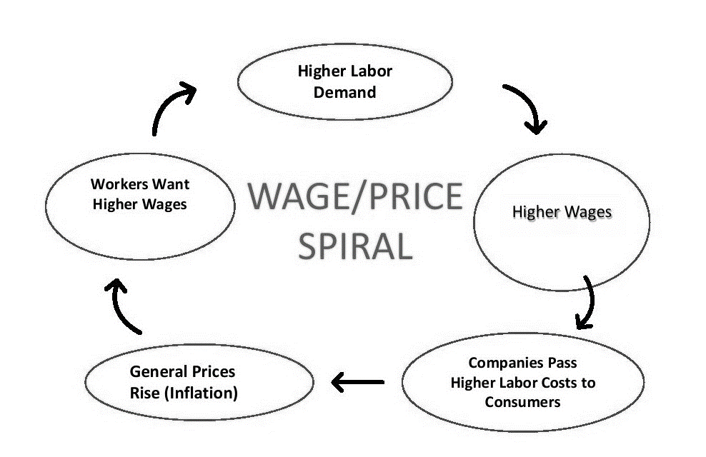
Inflationary Spiral
Notes:
An inflationary spiral, also known as a wage-price spiral, is a self-reinforcing cycle in which rising prices lead to higher wages, which in turn contribute to further price increases. It's a situation where inflation and rising wages reinforce each other, creating a feedback loop that can fuel persistent and accelerating inflation.
Here's how an inflationary spiral typically unfolds:
Initial Increase in Prices: The spiral often begins with some initial increase in prices, which could be due to various factors such as increased demand, supply shortages, or rising production costs (e.g., higher energy prices, raw material costs, or labor costs).
Workers Demand Higher Wages: As prices rise, workers may perceive a decline in their purchasing power, leading them to demand higher wages to maintain their standard of living. Labor unions may negotiate for wage increases to compensate for the higher cost of living.
Wage Increases: When employers grant wage increases to workers, labor costs rise for businesses. To cover these higher costs, firms may raise prices for their goods and services, passing on the increased expenses to consumers.
Further Price Increases: Higher prices lead to a new round of cost-push inflation, as businesses pass on their increased production costs to consumers. Consumers, in turn, may demand even higher wages to offset the rising cost of living, perpetuating the cycle.
Repeat Cycle: The cycle continues as rising wages contribute to further price increases, which lead to additional demands for wage hikes. This repetitive process can result in a spiral of increasing prices and wages, feeding off each other and driving inflation rates higher.
The inflationary spiral can be fueled by factors such as inflation expectations, supply-demand imbalances, and the behavior of economic agents (consumers, workers, businesses) responding to price changes. Once the spiral gains momentum, it can be challenging to break, as expectations of future inflation become entrenched, further fueling wage and price pressures.
To combat an inflationary spiral, policymakers may need to implement contractionary monetary and fiscal policies to cool down the economy, reduce aggregate demand, and bring inflation under control. These measures could include raising interest rates to dampen borrowing and spending, reducing government spending or increasing taxes to curb demand, and implementing supply-side policies to address underlying cost pressures. Additionally, efforts to manage inflation expectations and promote wage-price stability through dialogue with labor unions, businesses, and the public can help prevent the escalation of an inflationary spiral.

Slide 9
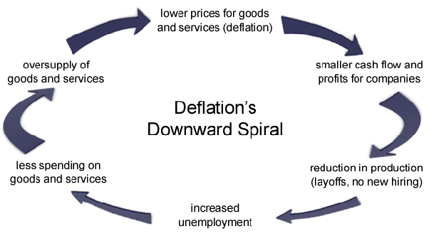
Deflationary Spiral
Notes:
A deflationary spiral, also known as a deflationary cycle, occurs when falling prices lead to lower consumer spending, reduced business investment, and declining wages, which in turn exacerbate the deflationary pressures. It's a self-reinforcing downward trend in prices and economic activity that creates a feedback loop, potentially leading to prolonged economic stagnation.
Here's how a deflationary spiral typically unfolds:
Initial Deflationary Shock:
The spiral often begins with an initial shock to the economy, such as a sharp decline in aggregate demand, a contraction in credit availability, or a negative supply shock. This shock leads to a decrease in prices for goods and services.
Decreased Consumer Spending:
Falling prices can lead consumers to delay purchases in anticipation of further price declines, reducing overall consumer spending. This decline in consumer demand contributes to lower sales for businesses.
Declining Business Investment:
With lower demand for their products, businesses experience reduced revenues and profits. They respond by cutting back on production and investment to adjust to the decreased demand. This reduction in business investment further dampens economic activity.
Wage Cuts and Unemployment:
Businesses facing reduced sales and profits may implement cost-cutting measures, such as layoffs, wage cuts, or reduced work hours. This leads to lower household incomes and increased unemployment, further reducing consumer spending.
Further Price Declines:
The combination of reduced consumer spending, declining business investment, and rising unemployment intensifies deflationary pressures, leading to further price declines across a wide range of goods and services.
Repetitive Cycle:
The deflationary spiral continues as falling prices, reduced spending, and declining economic activity reinforce each other in a self-perpetuating cycle. This repetitive process can lead to prolonged periods of economic stagnation, low growth, and high unemployment.
Breaking out of a deflationary spiral can be challenging, as deflationary expectations become entrenched, making it difficult to stimulate demand and restore confidence in the economy. Policymakers may need to implement expansionary monetary and fiscal policies to boost aggregate demand, support investment and consumption, and address the underlying causes of the initial shock. Additionally, efforts to manage inflation expectations and restore confidence in the economy through communication and policy measures may be necessary to mitigate the risk of a deflationary spiral.

Slide 10
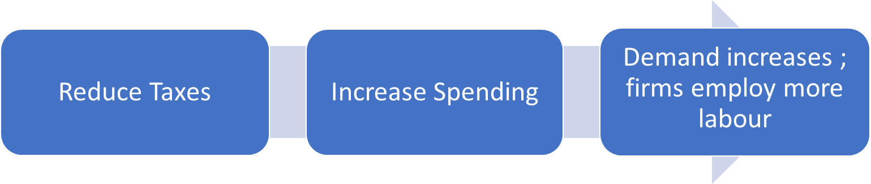
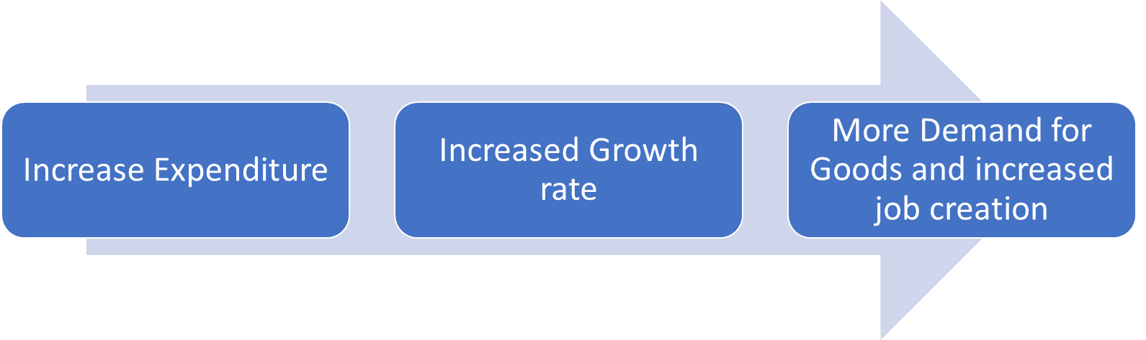
Fiscal policy objectives: Unemployment Target: Job Creation
Notes:
Fiscal policy can affect unemployment through its impact on aggregate demand, investment, and consumer spending. By adjusting government spending and taxation, fiscal policy can influence the level of economic activity, which in turn affects employment levels. Here's how fiscal policy can impact unemployment:
Expansionary Fiscal Policy and Unemployment:
Expansionary fiscal policy involves increasing government spending or reducing taxes to stimulate economic activity. This can lead to higher aggregate demand, increased production, and job creation.
For example, during a recession or period of high unemployment, the government may implement infrastructure projects, such as building roads and bridges, or invest in education and healthcare. This creates jobs directly in construction and related industries, as well as indirectly through increased demand for goods and services.
Tax cuts can also stimulate consumer spending, leading to increased demand for goods and services, which can prompt businesses to hire more workers to meet the rising demand.
Contractionary Fiscal Policy and Unemployment:
Conversely, contractionary fiscal policy involves reducing government spending or increasing taxes to cool down an overheated economy or reduce inflationary pressures. While contractionary fiscal policy may help control inflation, it can also lead to a slowdown in economic activity and higher unemployment.
For example, if the economy is experiencing high inflation, the government may reduce spending on non-essential programs or increase taxes to reduce consumer spending. This can lead to decreased demand for goods and services, lower production levels, and potential job losses in affected industries.
Automatic Stabilizers:
Certain aspects of fiscal policy, known as automatic stabilizers, can help stabilize employment levels during economic downturns without the need for explicit policy changes.
Examples of automatic stabilizers include unemployment insurance, welfare programs, and progressive income taxes. During periods of economic weakness or rising unemployment, these programs automatically expand, providing income support to individuals and families affected by job loss or reduced income. This helps maintain consumer spending levels and mitigates the impact of unemployment on overall economic activity.
Overall, fiscal policy can play a significant role in influencing unemployment levels by affecting aggregate demand, investment, and consumer spending. By implementing appropriate fiscal measures, policymakers can help support job creation and reduce unemployment during economic downturns while also promoting sustainable economic growth.

Slide 11
Fiscal Policy Objectives: Redistribution of Income
Government can take an active role in creating a more equitable distribution of income and wealth in an economy.
Government can achieve this through:
Government expenditure
Taxation
Design of policies should take into account the administrative capacity and efficiency
Notes:
Fiscal policy can play a crucial role in redistributing income by altering taxation and government spending policies to transfer resources from higher-income individuals or groups to lower-income individuals or groups. Here's how fiscal policy can help in income redistribution, along with an example:
Progressive Taxation:
One way fiscal policy can redistribute income is through progressive taxation, where tax rates increase as income levels rise. Progressive taxation ensures that higher-income individuals contribute a larger share of their income in taxes compared to lower-income individuals.
For example, a government may implement a progressive income tax system where individuals earning higher incomes are subject to higher tax rates. This means that individuals with higher incomes pay a larger proportion of their income in taxes compared to those with lower incomes.
The revenue generated from progressive taxes can then be used to fund government programs and services that benefit lower-income individuals, such as education, healthcare, social welfare programs, and infrastructure projects.
Means-Tested Benefits:
Fiscal policy can also redistribute income through means-tested benefits, which provide financial assistance to individuals or families based on their income levels or other eligibility criteria.
For example, a government may provide means-tested benefits such as food stamps, housing assistance, or childcare subsidies to low-income households. These benefits help alleviate financial hardship and improve the standard of living for individuals and families with limited means.
Means-tested benefits target assistance to those who need it most, ensuring that resources are directed towards those with the greatest need for support.
Social Insurance Programs:
Social insurance programs funded through fiscal policy, such as unemployment insurance, disability benefits, and pensions, can also contribute to income redistribution by providing financial support to individuals during periods of economic hardship or retirement.
For example, unemployment insurance provides income support to workers who have lost their jobs through no fault of their own, helping them meet their financial obligations while they search for new employment.
Similarly, pensions provide retirees with a source of income in their later years, reducing income inequality by ensuring that individuals have access to financial support in retirement.
By implementing progressive taxation, means-tested benefits, and social insurance programs, fiscal policy can help redistribute income from higher-income individuals to lower-income individuals, reducing income inequality and promoting social cohesion. However, the design and implementation of fiscal policies aimed at income redistribution must balance the objectives of equity and efficiency to ensure that they effectively target resources to those in need while also promoting economic growth and prosperity.

Slide 12
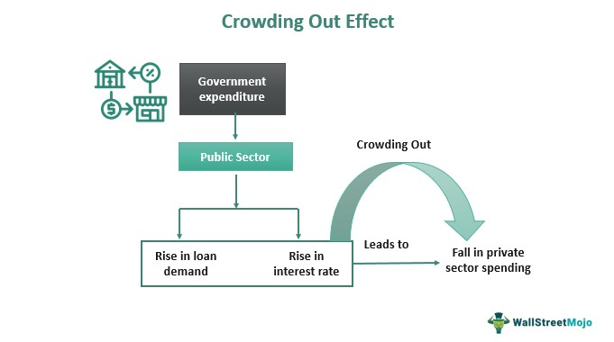
Notes:
The crowding out effect occurs when increased government spending leads to a decrease in private sector spending or investment, often through higher interest rates or reduced availability of resources. Here's a simple example to illustrate the crowding out effect:
Imagine a small economy where there are limited resources available for borrowing, such as funds for investment or loans for businesses and individuals. Initially, the government isn't very active in borrowing these resources.
Before Government Intervention:
In the absence of significant government borrowing, private businesses and individuals have relatively easy access to borrow money from banks or financial markets to invest in projects, such as building factories or buying equipment.
Interest rates are low because there's plenty of available funds for borrowing, and private sector investment is thriving.
Government Increases Borrowing:
Now, suppose the government decides to implement expansionary fiscal policy by increasing its borrowing to fund infrastructure projects, such as building roads, bridges, and schools, to stimulate economic growth and create jobs.
To finance these projects, the government needs to borrow money by issuing bonds or securities, effectively competing with private borrowers for available funds.
Crowding Out Effect:
As the government increases its borrowing, it absorbs a larger share of available funds in the economy. Banks and financial markets now allocate more resources to lend to the government instead of private businesses and individuals.
With fewer resources available for private borrowing, interest rates start to rise. This makes it more expensive for businesses and individuals to borrow money for their own investment projects.
As a result, some private sector investment projects may be postponed or canceled due to the higher borrowing costs, leading to a decrease in overall private sector spending and investment.
Outcome:
In this scenario, the government's increased borrowing has crowded out private sector investment by raising interest rates and reducing the availability of funds for private borrowing. This can dampen economic growth and offset some of the intended stimulative effects of the government's fiscal policy.
In summary, the crowding out effect occurs when increased government borrowing reduces the availability of funds for private sector investment, leading to higher interest rates and a decrease in private sector spending or investment.
Let's explore how policymakers can address the crowding out effect using an example:
Addressing the Crowding Out Effect:
To mitigate the crowding out effect and encourage private sector investment alongside government spending, policymakers can adopt several strategies:
Monetary Policy Coordination: The central bank can implement accommodative monetary policy measures, such as lowering interest rates or implementing quantitative easing, to counteract the upward pressure on interest rates resulting from increased government borrowing.
Targeted Fiscal Measures: The government can design fiscal policies that complement private sector investment, such as providing tax incentives or grants for businesses investing in sectors aligned with the government's infrastructure projects.
Public-Private Partnerships (PPPs): The government can engage in PPPs where private firms collaborate with the government to finance, build, and operate infrastructure projects. PPPs leverage private sector expertise and resources while sharing risks and costs between the public and private sectors.
Debt Management: The government can adopt prudent debt management practices to minimize the negative consequences of increased borrowing, such as lengthening the maturity of government debt and diversifying sources of financing.

Slide 13
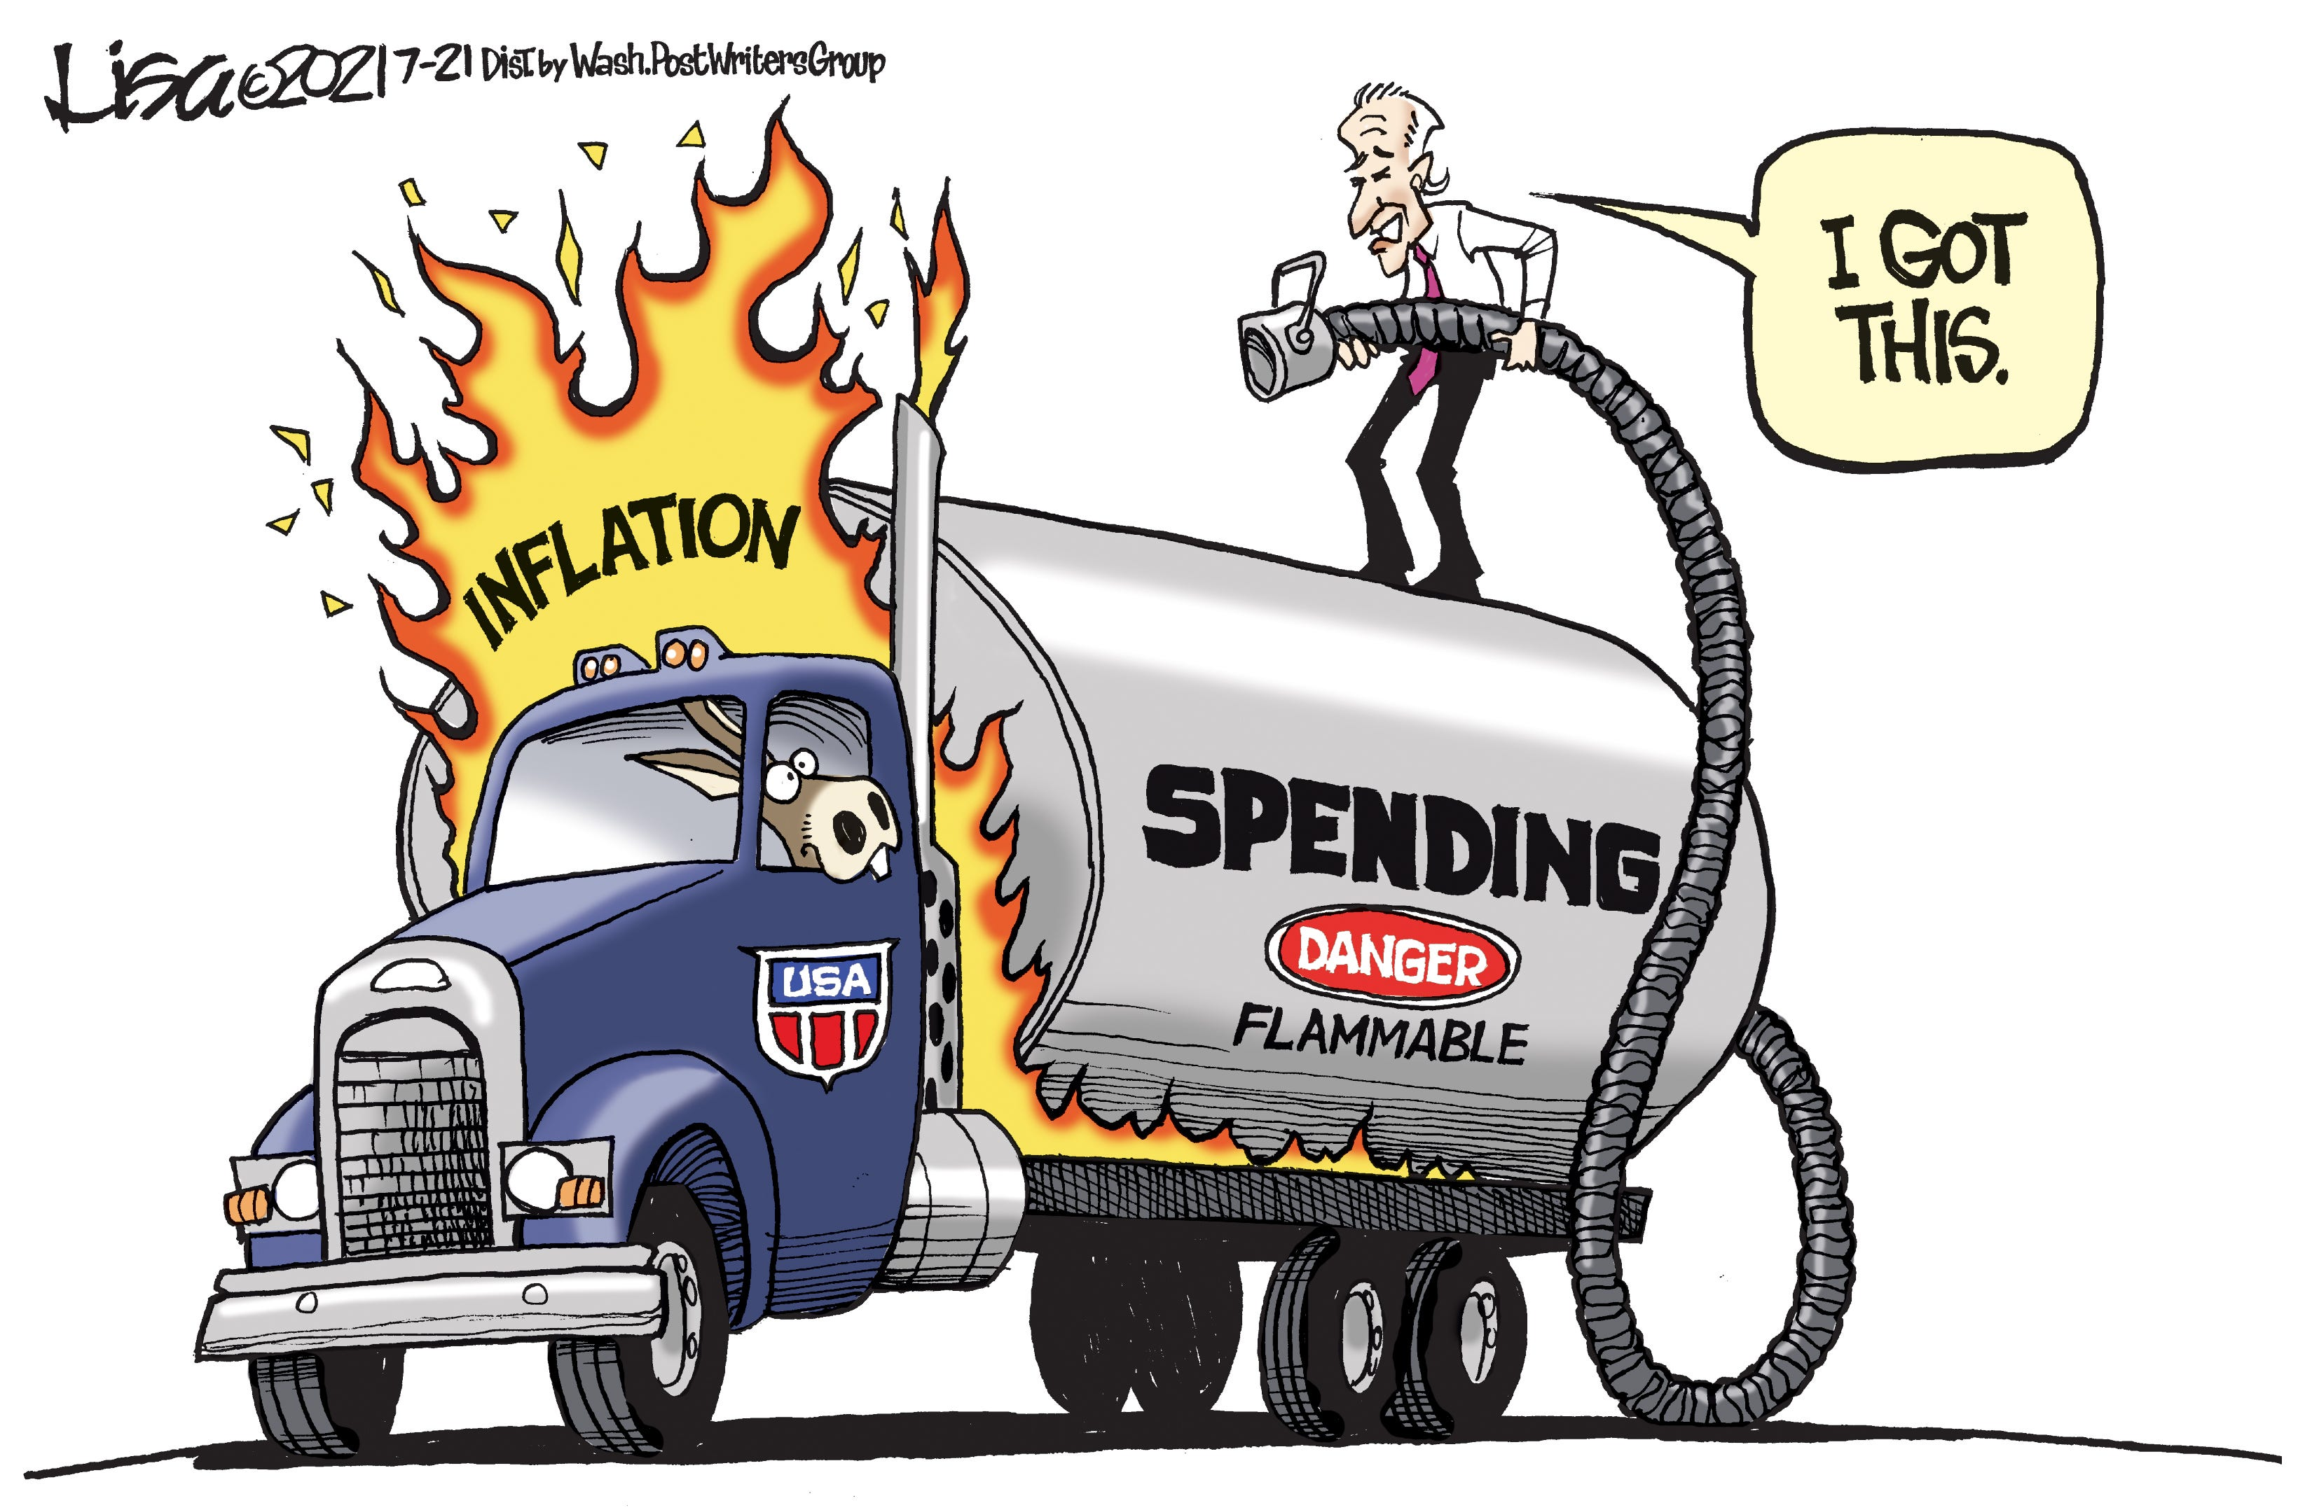
Fiscal Policy: Timing of Government Expenditure
Notes:
Another factor is the timing of government expenditure
So what is this cartoon trying to tell us, that there is an inflation fire and government is trying to pour petrol on it by increasing spending, the exact wrong thing to do in this situation which will further increase inflation. Now this example may seem exaggerated but government do this all the time when nearing the election time, because voters love it. Take an example, Suppose the inflation is already high in the economy, and the people are calling out the govt. as they are not able to buy the goods which they used to buy earlier. Now, what a government does is start giving cash transfer or subsidies to provide financial relief. So, what will happen now?? what happens is that people get happy that they are getting financial relief and now they can afford goods. But, the people fail to understand that this will provide temporary relief and in long run inflation will increase only.
If you start giving out more money to consumers without addressing the fundamental supply side problem ( increase in the production of goods and services), you have more money chasing the same amount of goods as earlier, so everything becomes more expensive.
Imagine an economy operating at or near full employment, where resources are fully utilized, and there is little slack in the economy. In this scenario, the economy is already experiencing upward pressure on prices due to high levels of demand.
Now, suppose the government decides to implement expansionary fiscal policy, such as increasing government spending or cutting taxes, to stimulate further economic growth.
The increased government spending or tax cuts inject additional demand into the economy, leading to higher levels of aggregate demand. As aggregate demand exceeds the economy's productive capacity, businesses are unable to meet the increased demand with a corresponding increase in supply.This excess demand leads to demand-pull inflation, where prices rise due to the imbalance between supply and demand. Consumers are willing to pay higher prices for goods and services, leading to upward pressure on prices.
Example:
Suppose the government of a country experiencing high unemployment decides to implement a large-scale infrastructure investment program to create jobs and stimulate economic growth.
The government finances this program by issuing bonds and borrowing funds from the financial markets.
The increased government spending on infrastructure projects generates demand for materials, equipment, and labor, putting upward pressure on prices in these sectors.
As businesses compete for scarce resources, wages and production costs rise, leading to higher prices for goods and services across the economy.
Consumers, seeing rising prices, may expect inflation to continue and adjust their behavior accordingly, demanding higher wages or increasing their spending to avoid future price increases. This further fuels inflationary pressures.
In this scenario, expansionary fiscal policy exacerbates inflation by increasing aggregate demand beyond the economy's productive capacity.The government's infrastructure investment program, while intended to stimulate growth and reduce unemployment, leads to higher inflationary pressures as businesses struggle to keep up with demand and costs rise throughout the economy.
Policy Response:
To address the inflationary pressures resulting from expansionary fiscal policy, policymakers may need to adopt contractionary monetary policy measures, such as raising interest rates or reducing the money supply, to cool down the economy and reduce inflationary pressures.
Additionally, policymakers may consider implementing supply-side policies to boost productivity and expand the economy's productive capacity, helping to alleviate inflationary pressures in the long term.
In summary, expansionary fiscal policy can aggravate inflation when implemented in an economy operating at or near full employment, leading to excess demand and upward pressure on prices. Policymakers must carefully balance the objectives of stimulating economic growth and managing inflation when formulating fiscal policy.

Slide 14
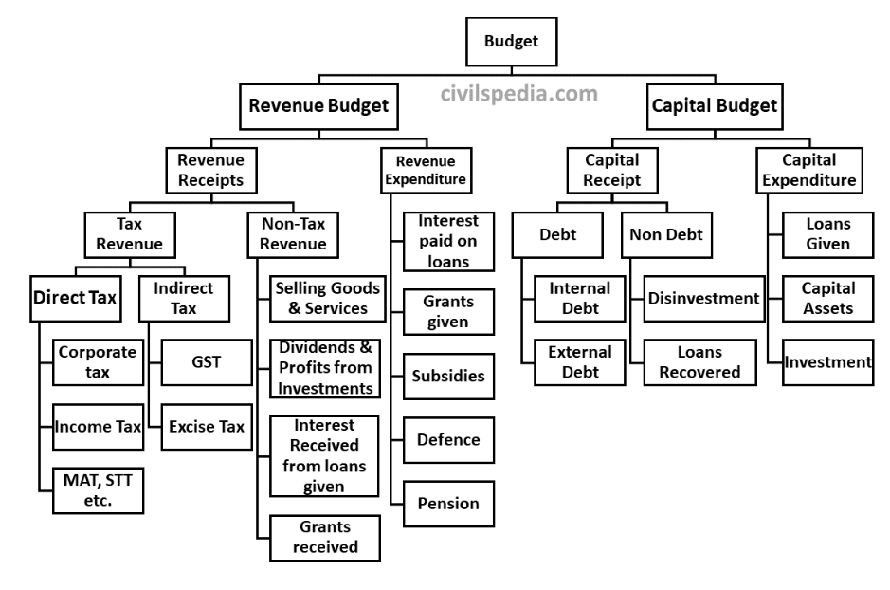
Budget Components
Notes:
Various components of the budget are shown in the chart given below. The budget can be broadly divided into Revenue and Capital parts, which can be further divided into the following categories.
Why do we divide the Budget like this?
According to Article 112, the Annual Financial Statement shall distinguish expenditure on revenue from other expenditures. Hence, any type of division following this condition is acceptable.
Revenue Budget contains the revenue receipts and the revenue expenditure.
Further, the revenue receipts can be divided into tax revenue and non-tax revenue.
Revenue expenditure can be further categorized into components like Interest paid by the government on loans taken, Grants given by the Union to States, Subsidies, Grants etc.
Revenue Account
The revenue account shows the current receipts of the government and the expenditure that can be met from these receipts.
Revenue Receipts: RR are receipts of the government incomes which cannot be reclaimed back by the citizens from the government.
Revenue Expenditure
The expenditure incurred by the government that neither creates any physical/financial asset nor reduces the liability of the government. The Revenue expenditure relates to the day to day functioning of the government.
Revenue expenditure is expenditure for normal running of the government department and various services, interest charges on debt incurred by government, subsidies and so on.
Example: Salaries of employees, Interest payments on past debts, grants given to state governments etc.
The Capital Account
The capital budget is an account of assets as well as liabilities of the central government.
Capital Receipts: All those receipts of the government which either creates liability or reduces financial asset are capital receipts.
Examples: Market borrowings by the government from the public, Borrowings from the RBI, Borrowings from commercial banks or financial institutions through thesale of T-BILLS, loans received from foreign governments or international financial institutions, post office savings, post office saving certificates and PSU’s Disinvestment.
Capital Expenditure: All those expenditures of the government which either result in the creation of physical/financial assets or reduction in financial liabilities.
Examples: Purchase of land, machinery, building and equipment’s; investment in shares; loans and advances by the central government to state governments and UTs.
Capital Expenditure is also classified as plan and non-plan capital expenditure. Plan expenditure relates to central Five-year Plan and Non-Plan relates to expenditure not covered under the Five-year
What is Tax?
Tax is a compulsory payment by the person or legal entity (like a company) to the government in return for which the payer can’t claim any specific benefit from the government.
Tax is a legal obligation that taxpayers can’t refuse to pay.
Unlike Revenue Receipts, Capital Receipts are those receipts that lead to a claim on the government.
In simple words, this is such cash received by the government that needs to be paid back by the government in the future.
It can be further divided into debt and non-debt.
Debt Receipt
Debt is the government borrowings. Government can borrow money either internally or externally.
Internal Debt
Internal debt is a loan taken by the government from the citizens or different institutions within the country.
Primary sources of Internal Borrowings include
Individuals who buy the bonds issued by governments.
Banks purchasing government bonds and securities.
Institutions like LIC, GIC etc., can also buy government bonds.
Provident fund
Small saving schemes
2 External Debt
The external loan is the loan taken from the government of other countries or an international organization (like the World Bank, IMF, BRICS Bank etc.).

Slide 15
What is Government Deficit
A government deficit is the amount of money in the budget by which the spending done by the government surpasses the revenue earned by it. This deficit presents a picture of the financial health of the economy.
There are several measures that apprehend a government deficit, and they have their own inferences for the economy, such as:
Revenue deficit
Fiscal deficit
Primary deficit
Notes:
When a government spends more than it collects by way of revenues, it incurs deficits. There are various kinds of deficits incurred by the government, and each has its own implications.

Slide 16
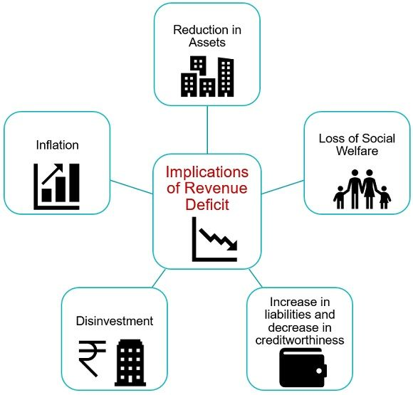
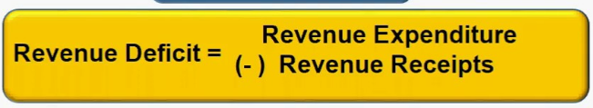
Revenue Deficit
When the revenue expenditure of the government is in excess of the government receipt, it results in a Revenue Deficit. It covers those transactions only that have an impact on the current income and expenditure of the government.
Notes:
Revenue deficit indicates indebtedness in the present budget owing to total revenue receipts and expenses proposed in the budget. It is a situation when the revenue expenditure is in excess of the revenue receipt. All such transactions having an influence over the current income and expenditure of the government are covered here.
A revenue deficit refers to the surplus of the government’s revenue expenditure over the revenue receipts.
Revenue deficit = Revenue expenditure – Revenue receipts
This deficit only incorporates current income and current expenses. A high degree of deficit symbolizes that the government should reduce its expenses. The government may raise its revenue receipts by raising income tax. Disinvestment and selling off assets is another corrective measure to minimise a revenue deficit.
It is an indicator of dissavings by the government, as well as the utilization of savings of different sectors, to finance a certain portion of its consumption expenditure.
It shows that the government would need to raise money by borrowing not just for financing its investment but also for fulfilling the consumption requirement.
It creates a stock of debt and interest liabilities and pushes the government to reduce expenditure.
Here's how a revenue deficit can lead to a reduction in assets:
Increased Borrowing: To cover the shortfall between revenue and expenditure, the government must borrow funds from various sources, such as issuing bonds or taking loans. This borrowing adds to the government's liabilities, as it must repay the borrowed amount along with interest in the future.
Accumulation of Debt: Over time, if revenue deficits persist, the government's borrowing accumulates, leading to a buildup of debt. This debt represents a claim on future government revenue and assets to meet repayment obligations.
Interest Payments: As the government accumulates debt, it incurs interest payments on the borrowed funds. These interest payments represent an ongoing expenditure that must be financed from future revenue sources, further straining the government's finances.
Impact on Assets: The accumulation of debt and interest payments reduce the government's financial resources available for investment in productive assets or public services. Instead of allocating resources towards infrastructure development, social programs, or other productive investments, a significant portion of government revenue may be diverted towards servicing debt obligations, leading to a reduction in assets over time.
In summary, a revenue deficit can indirectly contribute to a reduction in assets by necessitating increased borrowing, accumulation of debt, and diversion of resources towards debt servicing rather than investment in productive assets or public services. It underscores the importance of fiscal discipline and prudent financial management to ensure the long-term sustainability of government finances and preserve assets for future generations.
Persistent revenue deficits can erode investor confidence in the government's ability to manage its finances effectively. Investors may become concerned about the sustainability of government debt levels and the risk of fiscal instability. This can lead to capital flight and a reluctance to invest in government bonds or securities, further exacerbating the government's financing challenges.
Policy Uncertainty: Revenue deficits can create uncertainty about future government policies and economic stability. Investors may hesitate to commit capital to long-term projects or ventures if they are uncertain about the government's fiscal outlook or its ability to implement consistent economic policies. This uncertainty can dampen investor confidence and discourage investment in productive assets.

Slide 17
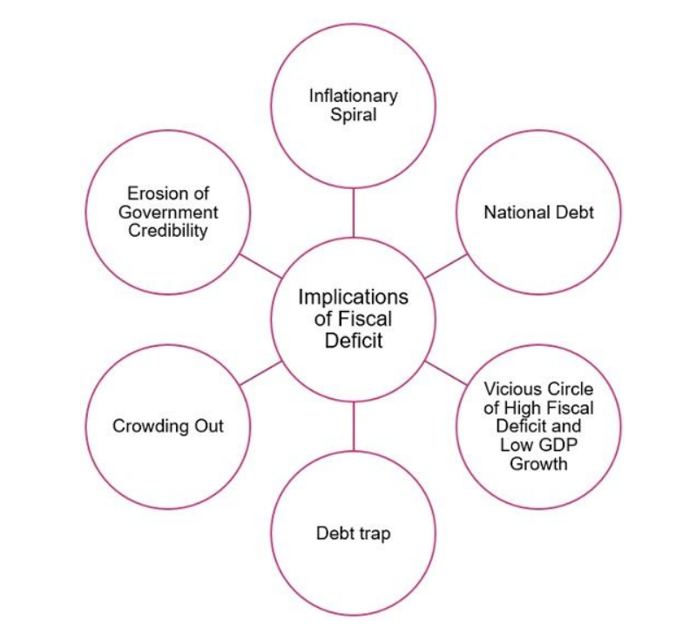
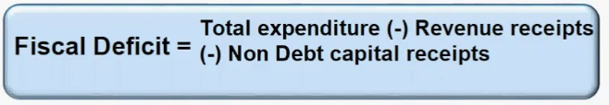
Fiscal Deficit
A Fiscal Deficit is a measure that expresses the entire shortfall in the non-debt resources to finance operations of the Central Government. It indicates the projected borrowing by the government to cope with its expenditures during a budget year. It is generally denoted as a percentage of GDP.
Notes:
A fiscal deficit is when there is a difference between the government’s total expenditure and total receipts not including borrowings, during a fiscal year. The reason behind the exclusion of borrowings is that borrowings are not considered as a part of government receipts. The fiscal deficit reflects the borrowing needs of the government, during a budget year, so as to finance the expenditure, including interest payments.
Consequences of Fiscal Deficit
Inflationary Spiral: Borrowing from RBI, increases the supply of money in the economy, which increases the general price level. A prolonged increase in the general price level results in an inflationary spiral
National Debt: Fiscal Deficit gives birth to the national debt. It hampers GDP growth, as a large portion of the national income is spent on repaying past debts.
Vicious Circle of High Fiscal Deficit and Low GDP Growth: When there is a high fiscal deficit constantly, it gives rise to a situation in which GDP growth remains low due to high fiscal deficit and the fiscal deficit remains high due to low GDP growth.
Debt trap: Borrowing leads to two main problems, with respect to the repayment of loan and payment of interest, because the payment of interest again increases the revenue deficit. And more borrowing will be required to finance interest payments which results in a debt trap.
Crowding Out: Crowding Out Effect is an outcome of Fiscal Deficit. It refers to a condition when high government borrowings because of high fiscal deficit, decreases the availability of funds for private investors. This reduces overall investment in the economy.
Erosion of Government Credibility: High fiscal deficit destroys the credibility of the government in both domestic and international markets. This lowers down the government’s credit rating, and the foreign investors will begin withdrawing money that they have invested in the domestic economy. As a result of which GDP is reduced.
In general, a Fiscal Deficit of around 3% of the GDP is regarded as manageable. High fiscal deficit is an indicator of fiscal indiscipline. It represents an economic situation wherein GDP growth is low and unemployment is high. Further, the economy moves towards stagnation and the revival becomes tough due to a lack of t foreign direct investment.
Conversely, Revenue Deficit indicates a shortage that has to be made up from capital receipts i.e. borrowings. To be precise it is a repayment burden in the future which do not match with any investment.
How Fiscal Deficit leads to Inflation?
Fiscal deficit occurs when a government's spending exceeds its revenues from taxes and other sources. This deficit is often financed through borrowing, which increases the money supply in the economy. Here's how fiscal deficit can lead to inflation:
Increased Demand: Government spending injects money into the economy, increasing aggregate demand. When demand exceeds supply, it can lead to inflationary pressure as producers may raise prices to match the increased demand.
Monetary Expansion: To finance the deficit, the government may borrow from the central bank. This increases the money supply in the economy, leading to more money chasing the same amount of goods and services, which can contribute to inflation.
Crowding Out Effect: When the government borrows extensively to finance its deficit, it competes with private borrowers for funds. This can lead to higher interest rates, which may discourage private investment and consumption. However, if the government continues to spend, it can drive up prices without a corresponding increase in productivity, leading to inflation.
Expectations: Persistent fiscal deficits can create expectations of future inflation among consumers and businesses. People may anticipate higher prices in the future and adjust their behavior accordingly, leading to a self-fulfilling prophecy of inflation.
Currency Depreciation: If fiscal deficits are financed through borrowing from foreign sources or printing money, it can lead to a depreciation of the currency. A weaker currency can increase the cost of imported goods, leading to higher prices domestically.
Overall, while fiscal deficits are not inherently inflationary, their financing mechanisms and the context in which they occur can contribute to inflationary pressures in an economy.
Both fiscal deficit and revenue deficit can have adverse effects on an economy, but the extent of their harm depends on various factors, including the magnitude, persistence, and underlying causes of the deficits. Here's a comparison of the two:
Fiscal Deficit:
Definition: The fiscal deficit is the difference between total government expenditure and total revenue, including both revenue receipts (taxes, non-tax revenue) and capital receipts (borrowings and other liabilities).
Impact: A fiscal deficit indicates the extent to which a government is borrowing to finance its expenditures. While some level of borrowing may be necessary to support investment, excessive fiscal deficits can lead to a buildup of government debt, higher interest payments, and crowding out of private investment. Persistent and unsustainable fiscal deficits can undermine investor confidence, lead to inflationary pressures, and pose risks to long-term economic stability.
Revenue Deficit:
Definition: The revenue deficit is the difference between government revenue expenditure (expenditure on consumption and welfare programs) and revenue receipts (income from taxes and non-tax sources).
Impact: A revenue deficit specifically indicates that the government is spending more on consumption and welfare programs than it is earning from regular sources of revenue. While revenue deficits may be easier to finance in the short term compared to capital expenditures, they can signal inefficiencies in government spending, lack of fiscal discipline, and a reliance on borrowings to meet recurring expenses. Persistent revenue deficits can undermine fiscal sustainability, limit resources for productive investments, and erode investor confidence.
In summary, both fiscal deficit and revenue deficit have negative implications for an economy if not managed prudently. While fiscal deficit reflects the overall imbalance between government spending and revenue, revenue deficit specifically highlights the shortfall in funding for consumption and welfare programs. Effective fiscal management requires addressing both types of deficits to ensure long-term fiscal sustainability, promote economic growth, and maintain investor confidence.

Slide 18
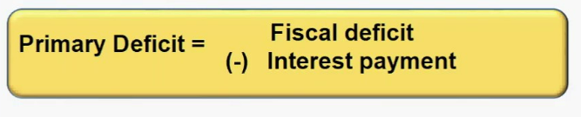
Primary Deficit
A primary deficit is the amount of money that the government requires to borrow from the interest payments on the formerly borrowed loans.
A zero deficit shows that there is a requirement for availing credit of borrowing for clearing the interest payment on the outstanding debt
Notes:
Primary deficit is referred to as the difference that exists between the fiscal deficit of the current year and the interest payment that was needed to be paid in the previous fiscal year. It is one of the three important measures of determining the government deficit.
It shows the requirement of borrowing of the government and excludes any kind of interest. It also highlights the amount of government expenses that needs to be met through borrowing other than the interest payment.
While fiscal deficit deals with the government’s total borrowings including the interest payment, primary deficit deals with the government’s borrowings excluding the interest payments.
Generally, when a loan is raised by the government it includes the interest payment amount also. This amount when subtracted from the principal loan amount indicates the primary deficit.
Calculation of primary deficit is represented by the following formula
Primary deficit = Fiscal deficit – Interest payments
Where,
Fiscal deficit = (Total expenditure – Total income of the government)
Interest payments refer to the previous year’s pending payments
A decrease in the primary deficit reflects the improvement in the fiscal health of the economy, when the primary deficit becomes zero, it suggests that the government only needs to borrow only to pay off the interest payments due from the previous year.
A high primary deficit suggests that the government is spending significantly more than it is collecting in revenue, even before accounting for interest payments on outstanding debt.
The borrowing requirement of the government includes interest obligations on accumulated debt.
The goal of measuring primary deficit is to focus on present fiscal imbalances.
To obtain an estimate of borrowing on account of current expenditures exceeding revenues, we need to calculate what has been called the primary deficit.
It is simply the fiscal deficit minus the interest payments
Gross primary deficit = Gross fiscal deficit – Net interest liabilities

Slide 19
Review Question
Question: Which of the following is not a part of the revenue receipts for the Government of India?
The receipts from the collection of interest amount from its debtors
The receipts from the collection of corporate taxes
The dividends and profits received from the public sector units
The receipts from disinvestment of public sector undertakings
Notes:
4.

Slide 20
Review Question
Question: Which of the following items is classified as a Capital Receipt in the budget for the Government of India?
The receipts from the collection of income tax
The borrowings made by the government from the public
The dividends and profits received from the public sector units
The interest receipts for loans given by the government to its debtors
Notes:
2.

Slide 21
Review Question
Question: Which of the following agencies is responsible for formulating the Fiscal Policy in India?
Securities and Exchange Board of India (SEBI)
Reserve Bank of India (RBI)
Ministry of Finance, Government of India
National Bank for Agricultural and Rural Development (NABARD)
Notes:
3.

Slide 22
Review Question
Question: One of the most significant fiscal policy objectives in India is to bring the revenue expenditures and receipts to the same level. Which of the following steps will help to achieve that objective?
The efforts to raise the total profits for public sector units
The efforts to improve the revenues from tax collection
The efforts to slow the growth rate for expenditures in the country
All of the above
Notes:
4.

